Slide 1
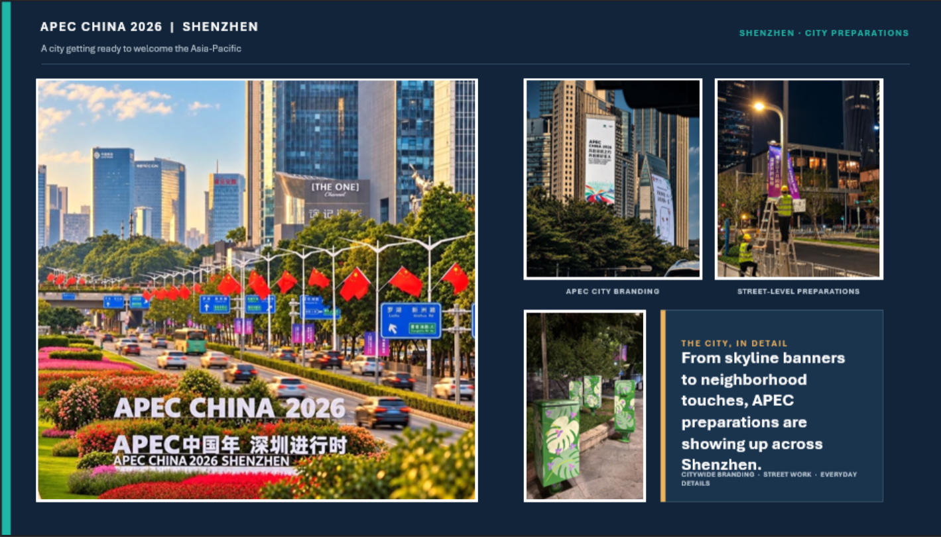

Slide 2


Slide 3
APEC IS HERE
HAS YOUR DAILY LIFE CHANGED?
SHENZHEN · APEC 2026
1
Was there a moment when you thought, “Shenzhen is really hosting an international event”? It could be a small detail, a particular scene.
STREET INTERVIEW · SHENZHEN
11 / 15

Slide 4
APEC IS HERE
HAS YOUR DAILY LIFE CHANGED?
SHENZHEN · APEC 2026
2
Have you noticed any interesting conversations among friends, family, or colleagues about APEC?
STREET INTERVIEW · SHENZHEN
08 / 15

Slide 5
APEC IS HERE
HAS YOUR DAILY LIFE CHANGED?
SHENZHEN · APEC 2026
3
Shenzhen is known as an open city. What is the most “open-minded” thing you've learned from living or working here?
STREET INTERVIEW · SHENZHEN
13 / 15

Slide 6
APEC IS HERE
HAS YOUR DAILY LIFE CHANGED?
SHENZHEN · APEC 2026
4
Sometimes big global events feel far away. Has APEC made you feel more connected to the world? Why or why not?
STREET INTERVIEW · SHENZHEN
10 / 15

Slide 7
APEC IS HERE
HAS YOUR DAILY LIFE CHANGED?
SHENZHEN · APEC 2026
5
If you could choose one word to describe Shenzhen today, what would it be and why?
STREET INTERVIEW · SHENZHEN
06 / 15

Slide 8
APEC IS HERE
HAS YOUR DAILY LIFE CHANGED?
SHENZHEN · APEC 2026
6
What's one example of cooperation that you see every day but people often take for granted?
STREET INTERVIEW · SHENZHEN
15 / 15

Slide 9
APEC IS HERE
HAS YOUR DAILY LIFE CHANGED?
SHENZHEN · APEC 2026
7
If you could introduce one innovation to improve your daily life, what would it be?
STREET INTERVIEW · SHENZHEN
14 / 15

Slide 10
APEC IS HERE
HAS YOUR DAILY LIFE CHANGED?
SHENZHEN · APEC 2026
8
If a foreign friend came to Shenzhen for APEC, where would you recommend taking them for a non-tourist experience—not Window of the World or Happy Valley?
STREET INTERVIEW · SHENZHEN
12 / 15

Slide 11
APEC IS HERE
HAS YOUR DAILY LIFE CHANGED?
SHENZHEN · APEC 2026
9
When did you first realize APEC was coming to Shenzhen? What caught your attention?
STREET INTERVIEW · SHENZHEN
01 / 15

